Slide 1
Social Media SIG
8/17/15

Slide 3
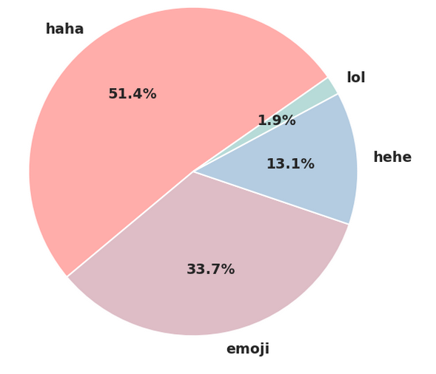

Slide 4
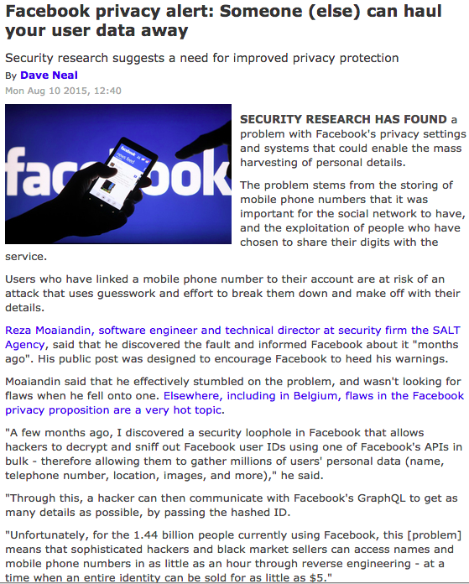

Slide 5
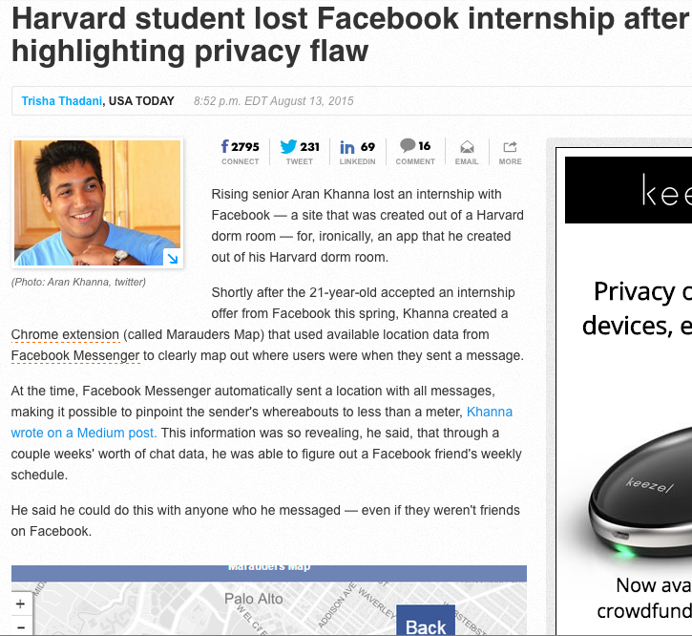

Slide 6
Privacy Settings

Slide 7
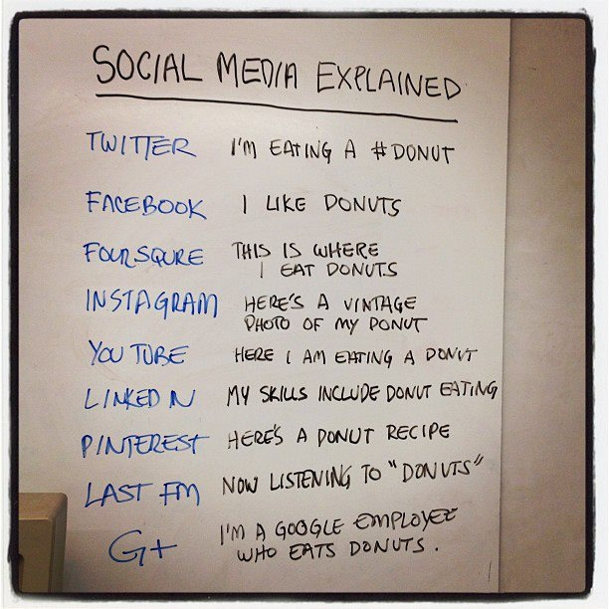

Slide 8
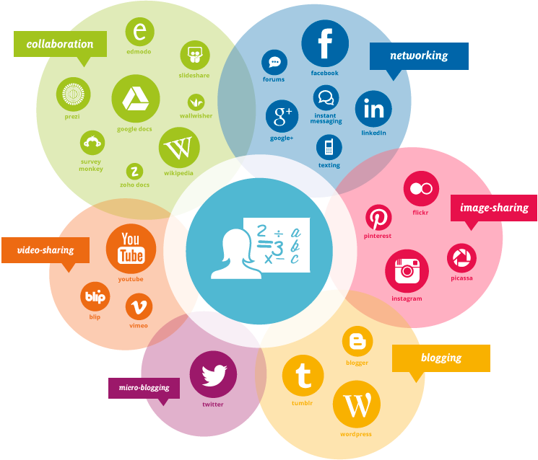

Slide 9
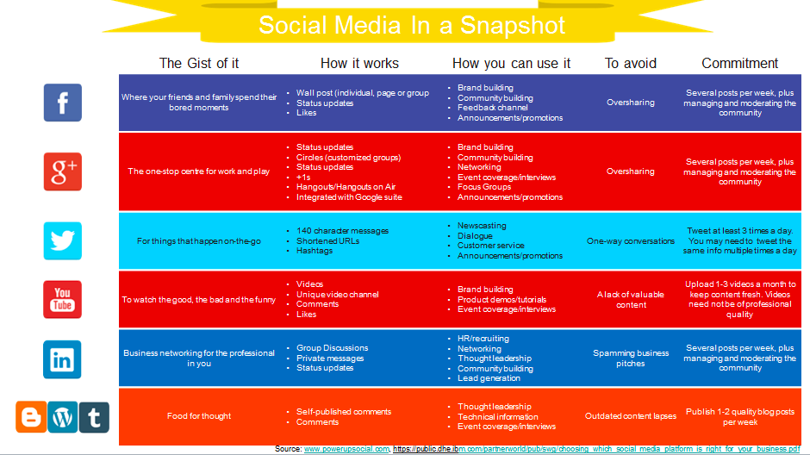

Slide 10
Links
http://bgr.com/2015/08/11/facebook-privacy-settings-setup-guide/
https://www.yahoo.com/tech/s/see-companies-tracking-facebook-block-123053940.html
http://www.wsj.com/articles/facebooks-laughable-data-shows-lol-isnt-funny-anymore-1439238707
http://www.wired.com/2015/08/how-to-use-facebook-privacy-settings-step-by-step/
http://www.theinquirer.net/inquirer/news/2421359/facebook-privacy-alert-someone-else-can-haul-your-user-data-away
http://www.usatoday.com/story/tech/2015/08/13/harvard-aran-khanna-facebook/31647295/
http://www.clickorlando.com/news/social-media-posting-guide-for-teens/34703672

